Slide 1
Investigation of Image Classification based on Transfer Learning and Siamese Network
Ke Fan, Abdullateef Almudaifer, Sungman Kang

Slide 2
Agenda
Objective
Dataset Processing
Transfer Learning
Implementation 1
Siamese Network
Implementation 2
Evaluation

Slide 3
Objective
Compare a simple Siamese network features with transfer learning approach on shoes dataset classification accuracy.
Investigate the effect of Siamese network on the features from transfer learning.

Slide 4
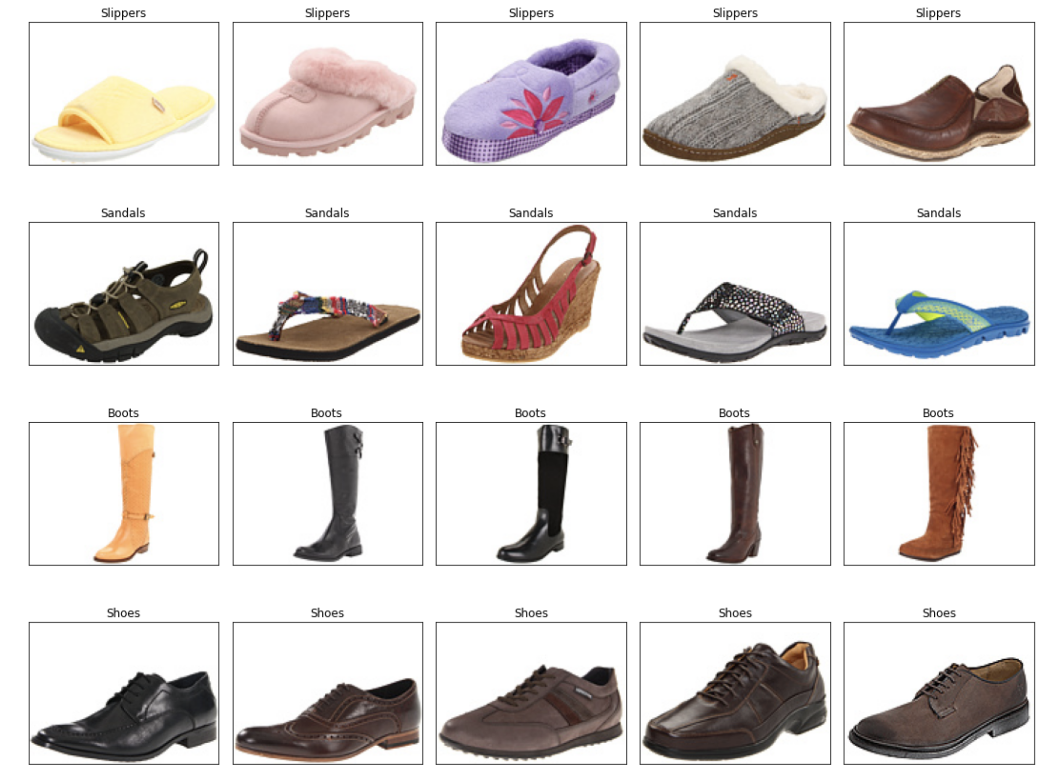
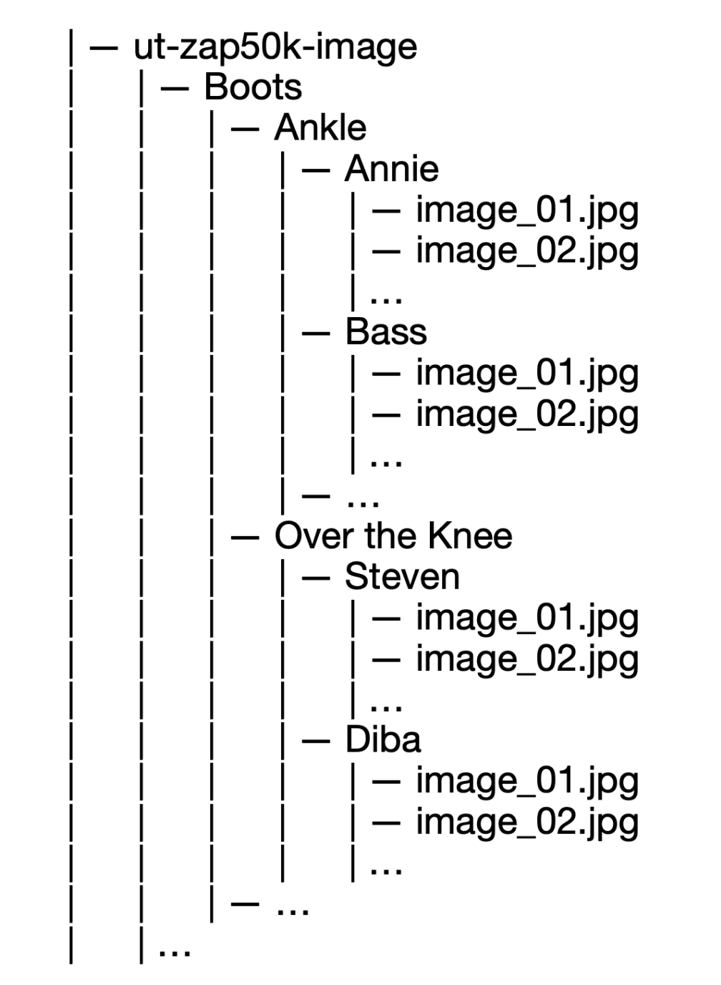
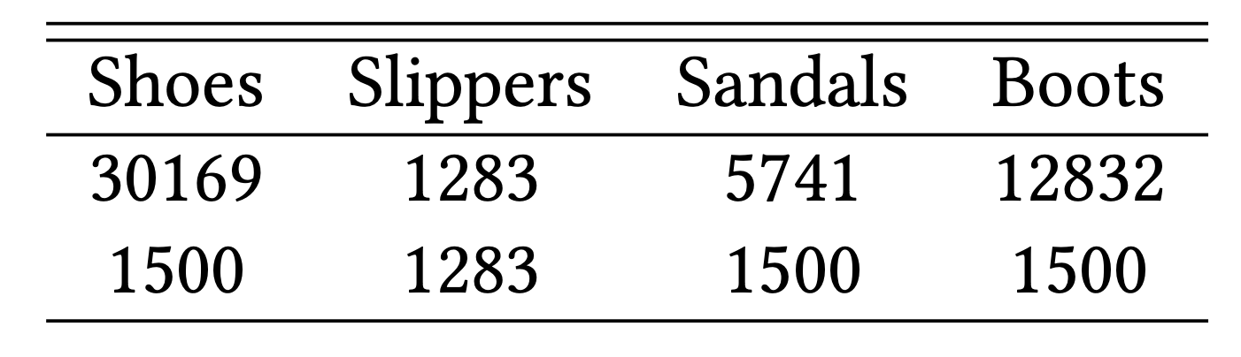
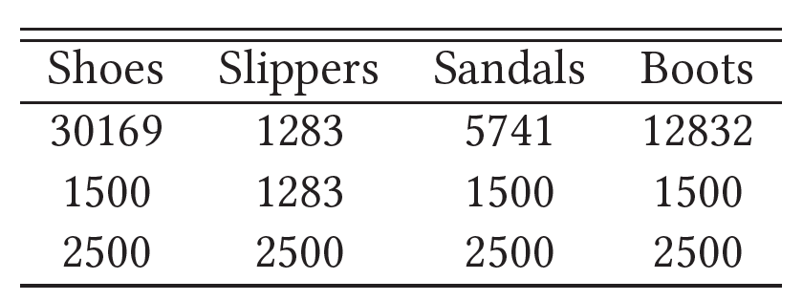
Dataset
Fig.1: Examples from the dataset.
http://vision.cs.utexas.edu/projects/finegrained/utzap50k/

Slide 5
Transfer Learning

Slide 6
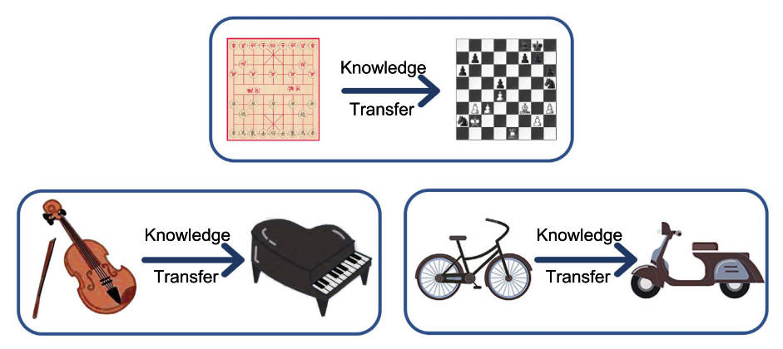
Transfer Learning
Fig. 2: Intuitive examples about transfer learning.
Source: A Comprehensive Survey on Transfer Learning https://arxiv.org/pdf/1911.02685.pdf

Slide 7
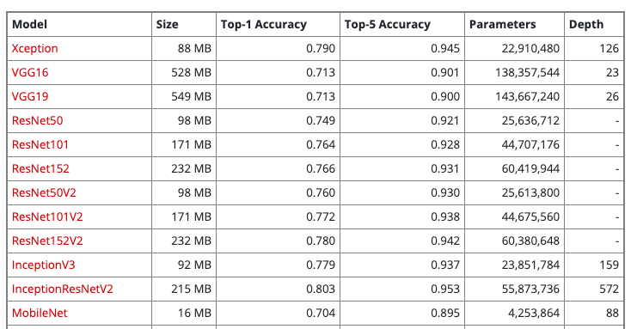
Xception
Table 1: part of available models on Keras applications
https://keras.io/api/applications/

Slide 8
Xception
Fig. 3: Xception architecture
Xception: Deep Learning with Depthwise Separable Convolutions https://arxiv.org/pdf/1610.02357.pdf

Slide 9
Implementation
scores
Probabilities
shoes
shoes
G.A.B
sandals
sandals
Xception
softmax
slippers
slippers
3, 3, 2048
2048
boots
boots
scores
Probabilities
FC
+
Relu
shoes
shoes
sandals
sandals
Xception
G.A.B
softmax
slippers
slippers
2048, 3, 3
2048
boots
boots
512
Figure 4: implemented transfer learning architectures. G.A.B: GlobalAveragePooling

Slide 10
Siamese Network

Slide 11
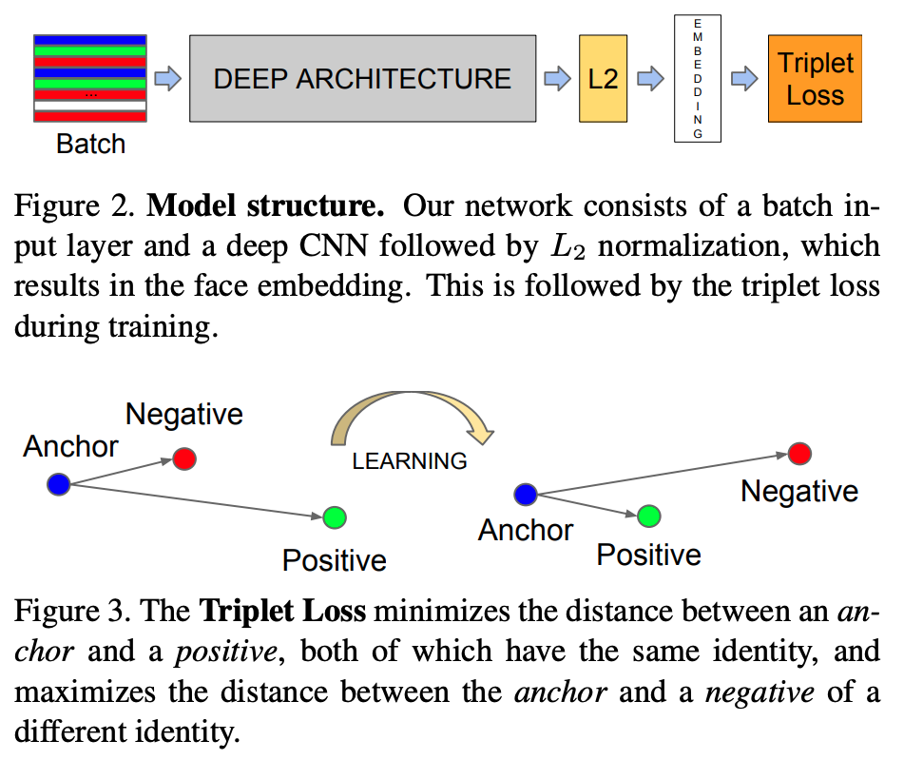
Siamese Network
FC
Loss
Classes
Our network consists of a batch input layer and a deep CNN followed by L2 normalization, which results in the image embedding. This is followed by a loss function during training. Furthermore, we add one more FC layer to generate classes output.
SCHOOL OF - to apply in all slides at the same time edit in Insert > Header & Footer

Slide 12
Typical CNN Architecture

Slide 13
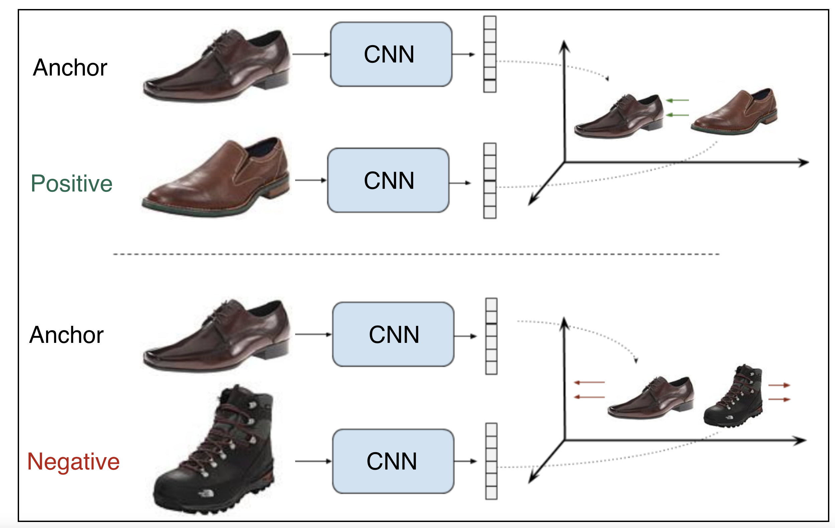
Contrastive Loss
Shared weights
pull
push
Shared weights
Figure X: Example of a contrastive ranking loss training setup
SCHOOL OF - to apply in all slides at the same time edit in Insert > Header & Footer

Slide 14
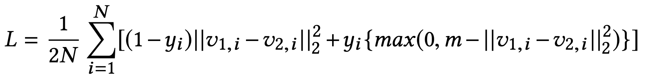
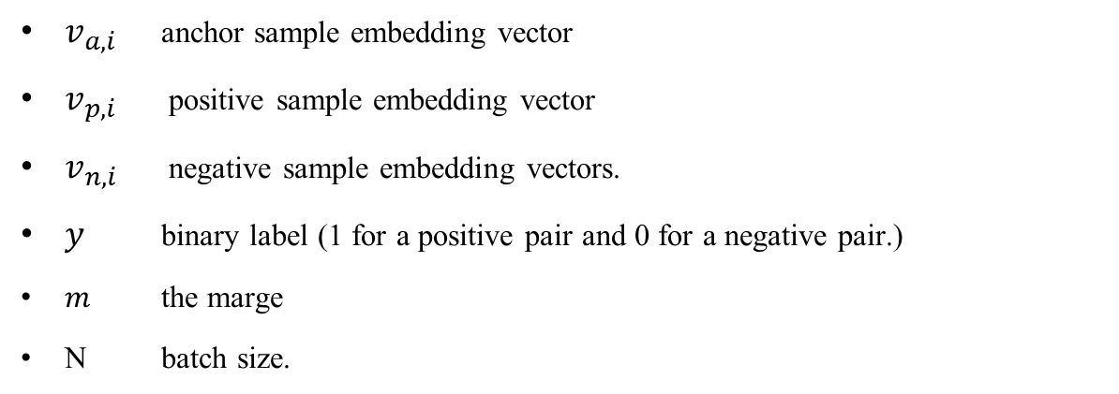
Contrastive Loss Function
$v_{a,i}$ anchor sample embedding vector
$v_{p,i}$ positive sample embedding vector
$v_{n,i}$ negative sample embedding vectors.
$y$ binary label (1 for a positive pair and 0 for a negative pair.)
$m$ the marge
N batch size.
SCHOOL OF - to apply in all slides at the same time edit in Insert > Header & Footer

Slide 15
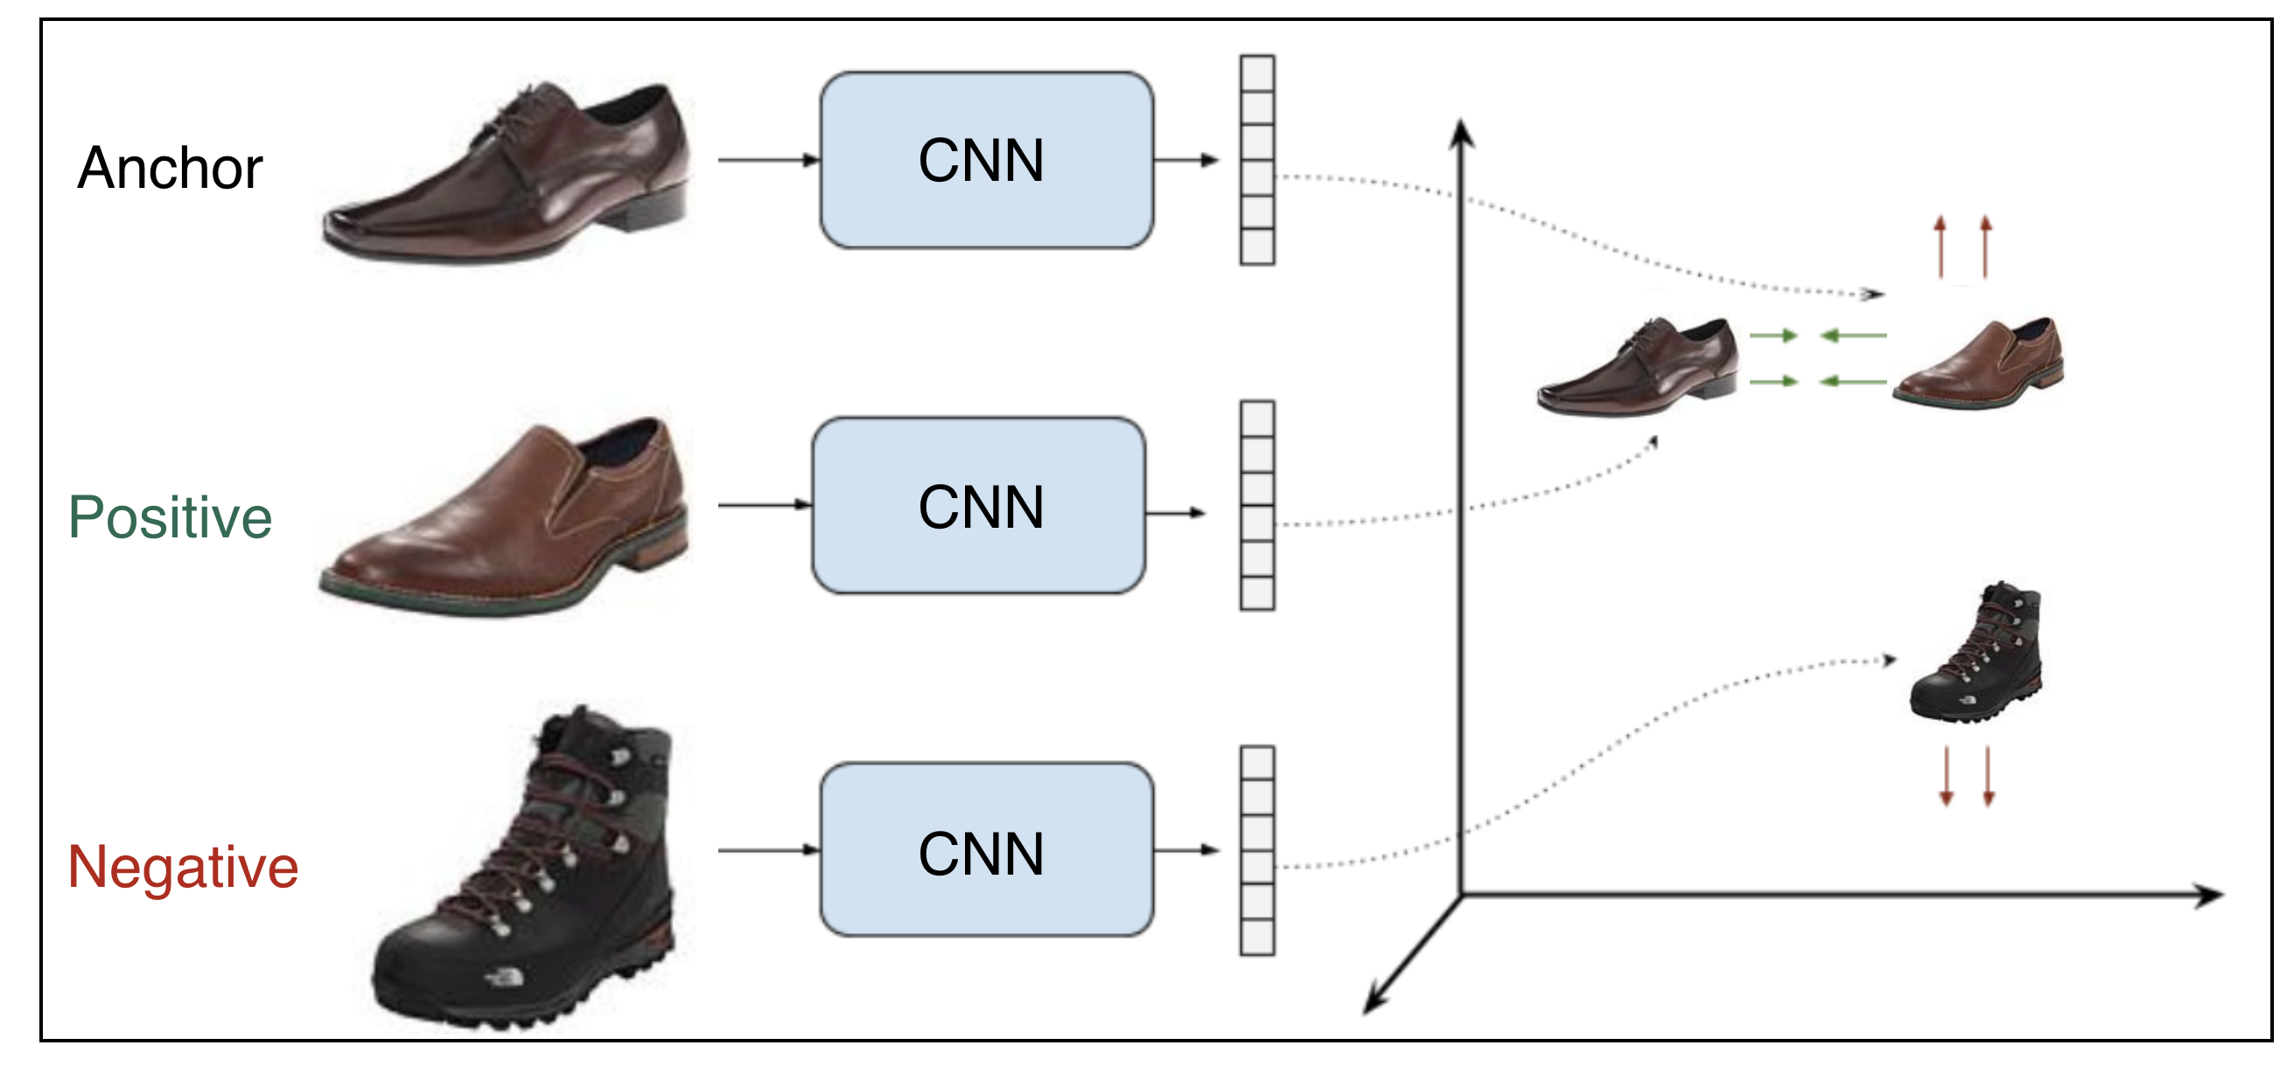
Triplet Loss
Shared weights
pull
push
Shared weights
Figure X: Example of a contrastive ranking loss training setup
SCHOOL OF - to apply in all slides at the same time edit in Insert > Header & Footer

Slide 16
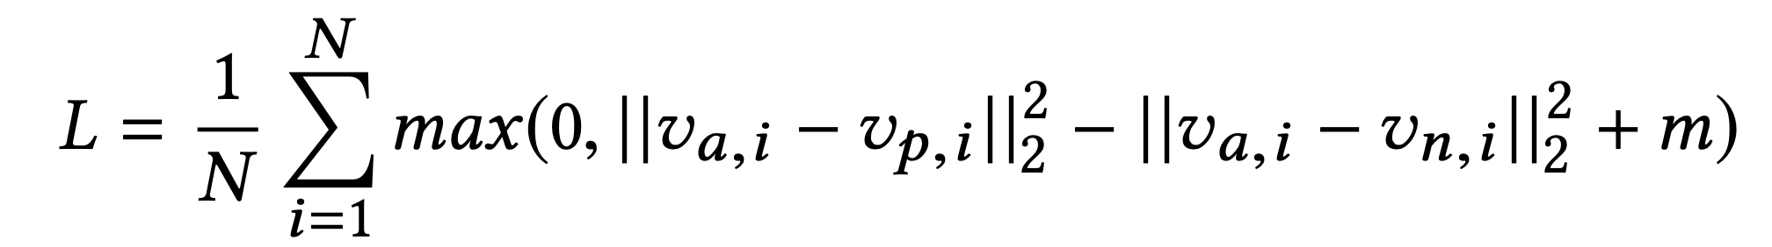
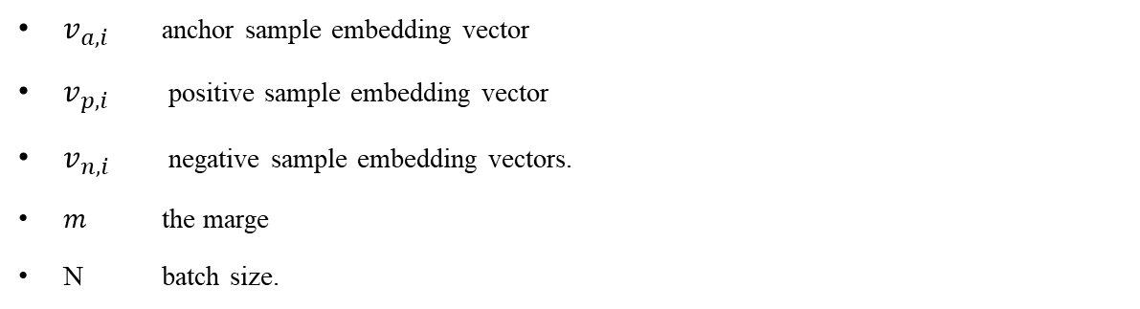
Triplet Loss Function
$v_{a,i}$ anchor sample embedding vector
$v_{p,i}$ positive sample embedding vector
$v_{n,i}$ negative sample embedding vectors.
$m$ the marge
N batch size.
SCHOOL OF - to apply in all slides at the same time edit in Insert > Header & Footer

Slide 17
Implementation

Slide 18
Pairs

Slide 19
Implementation
Offline pair mining
defined before training
Online triplet mining
defined for every batch during training

Slide 20
Evaluation

Slide 21
Evaluation – old run
model | Accuracy % | Epochs | Time (mins)
Xception (T0) | 91.8 | 20 | 1.8
Xception + dense (T1) | 90.7 | 20 | 3.5
Xception All (T2) | 95.1 | 10 | 5.4
Our Siamese + Con. Loss (S0) | 92.75 | 32 | 6
Our Siamese + Triplet. Loss (S1) | 91.02 | 20 | 2
Xception + Siamese (S2) | 95.85 | 10 | 2
model | Accuracy % | Epochs | Time (mins)
Xception (T0) | 89.9 | 20 | 4
Xception + dense (T1) | 89.3 | 20 | 4
Xception All (T2) | 94.0 | 10 | 6
Our Siamese + Con. Loss (S0) | 90.20 | 32 | 14
Our Siamese + Triplet. Loss (S1) | - | - | -
Xception + Siamese (S2) | - | - | -
Table1: Results on 1500 images
Table2: Results on 2500 images

Slide 22
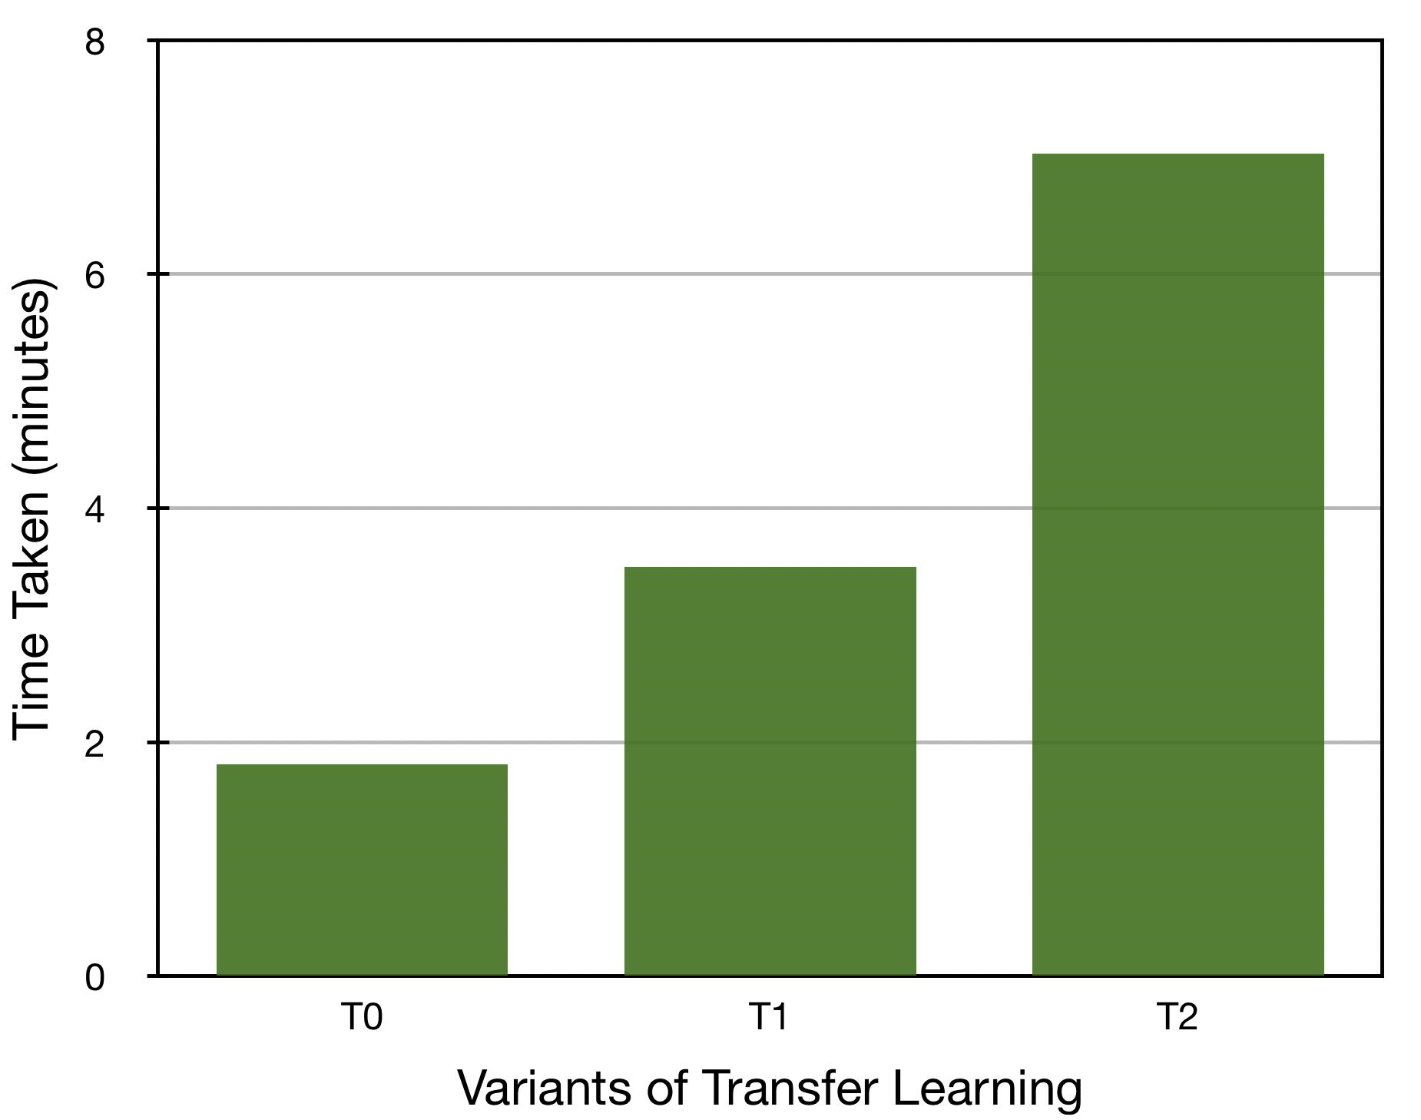
Comparison of Transfer Learning
Figure X: Description

Slide 23
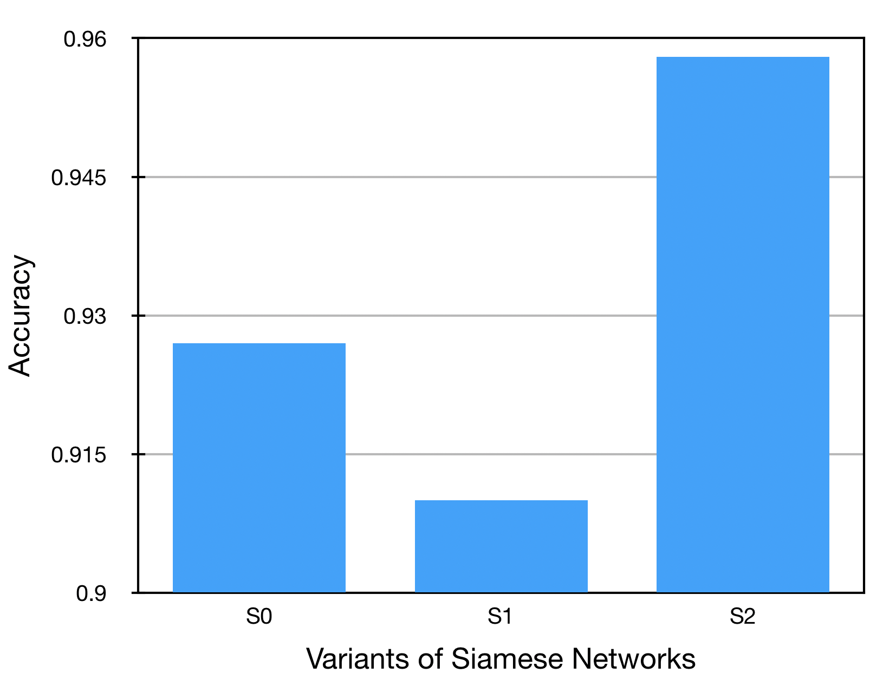
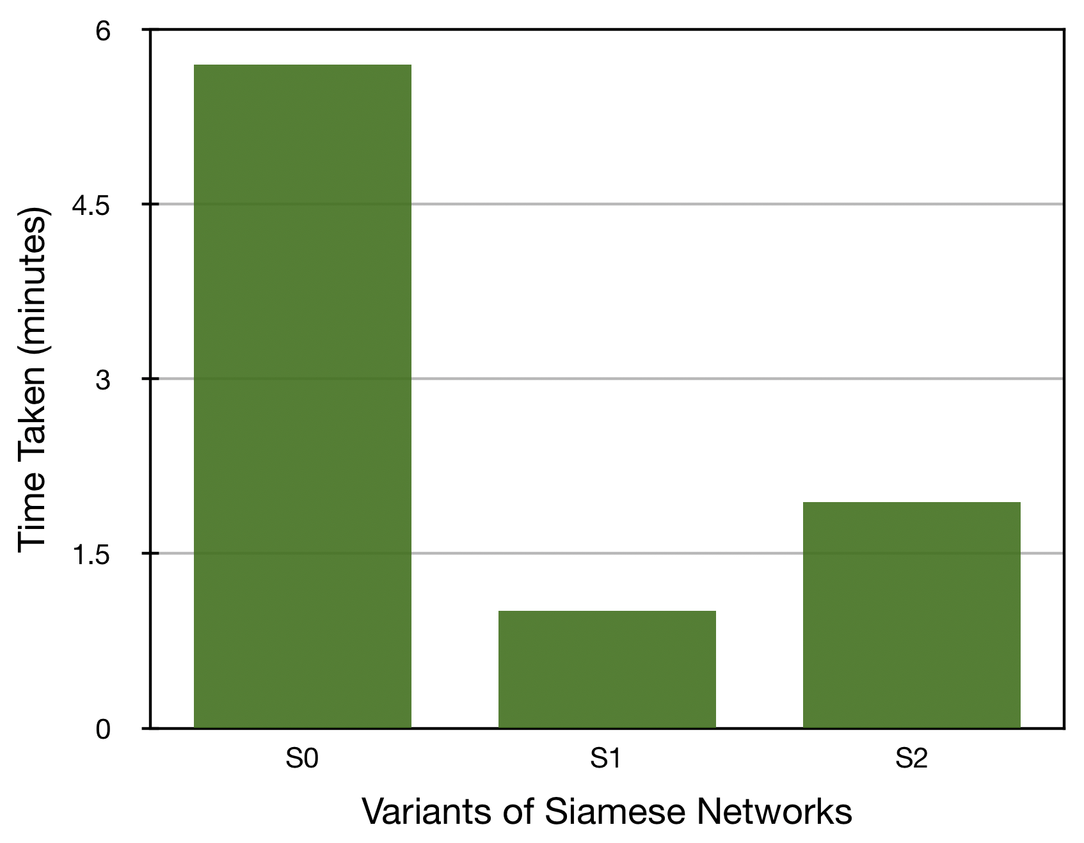
Comparison of Siamese Network
Figure X: Description

Slide 24
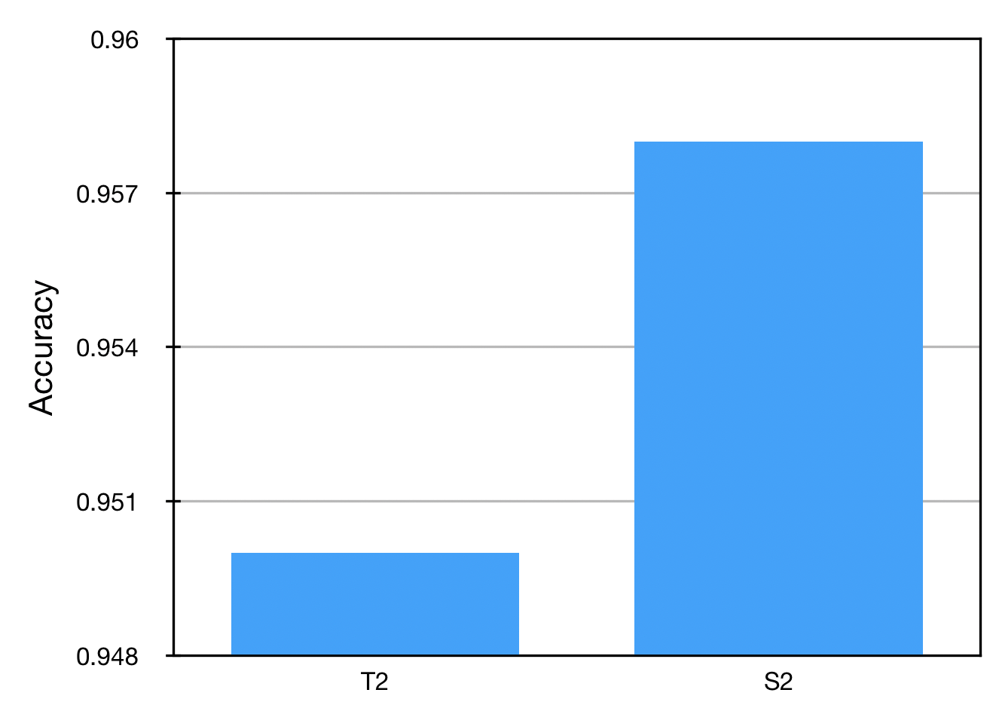
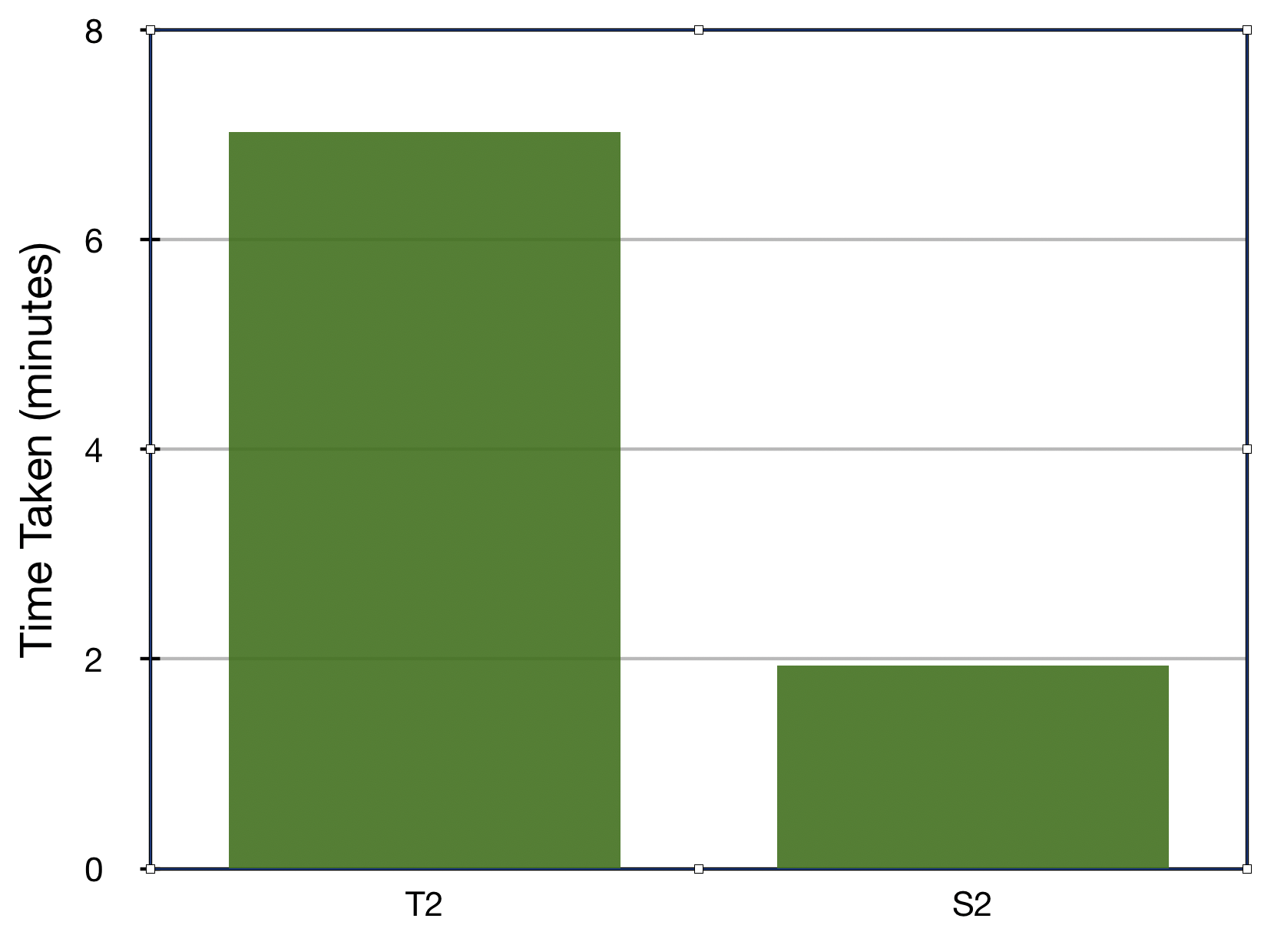
Comparison best models
Figure X: Description

Slide 25
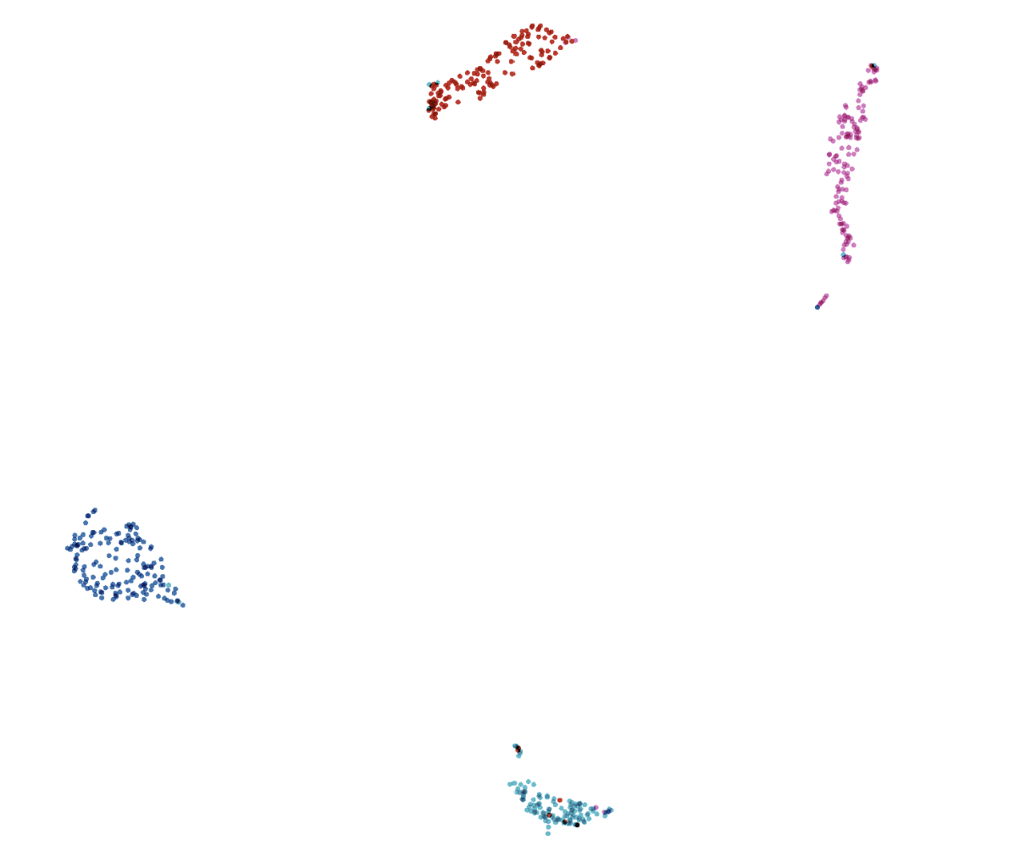
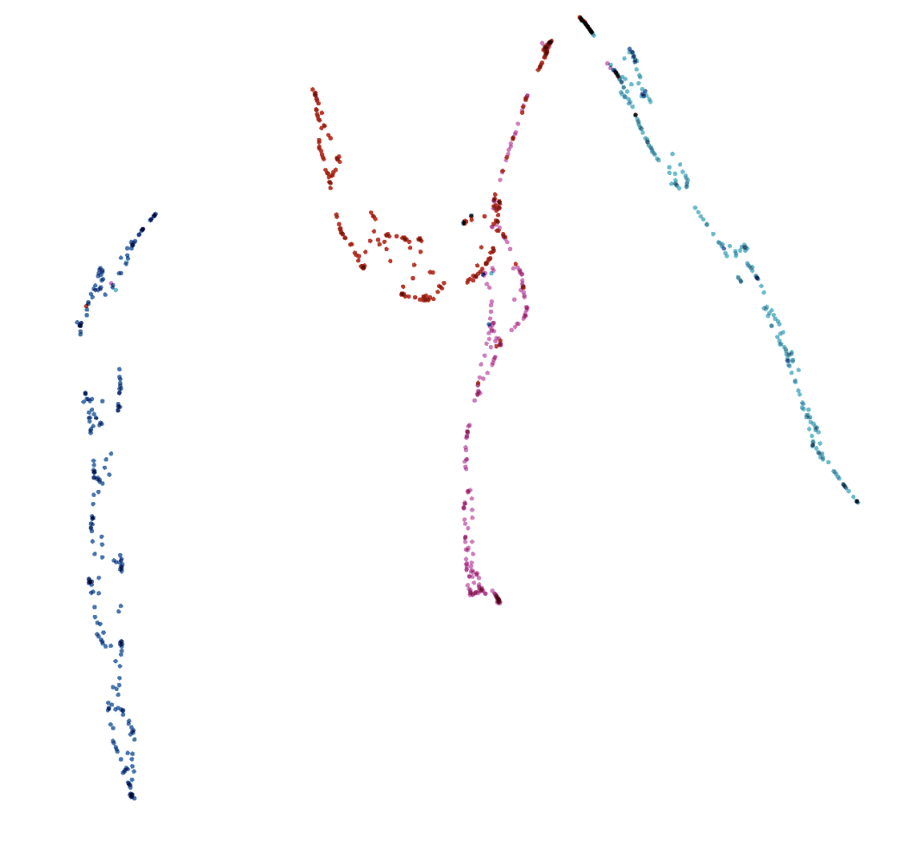
Comparison best models
(a) Xception + Siamese
(b) Xception all
Figure X: visualization of embedded test data projected to 2D space with UMAP using https://projector.tensorflow.org/

Slide 26
Thank you!

Slide 27
Triplet Loss
https://www.tensorflow.org/addons/tutorials/losses_triplet

Slide 28
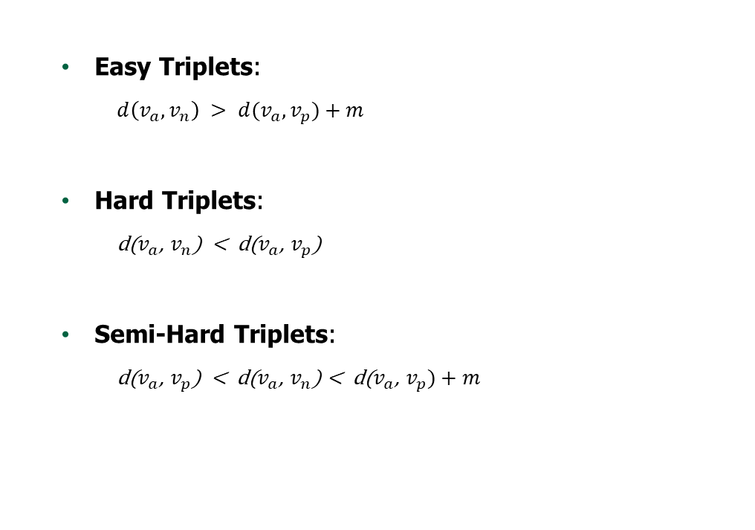
Triplet Mining
Easy Triplets:
$d\left(v_{a},v_{n}\right) > d(v_{a},v_{p})+m$
Hard Triplets:
d($v_{a}$, $v_{n}$) < d($v_{a}$, $v_{p}$)
Semi-Hard Triplets:
d($v_{a}$, $v_{p}$) < d($v_{a}$, $v_{n}$) < d($v_{a}$, $v_{p})+m$
Easy negatives
Semi-hard negatives
Hard negatives
margin
A
P
Figure X: Types of negatives - given an anchor and a positive
SCHOOL OF - to apply in all slides at the same time edit in Insert > Header & Footer

Slide 29
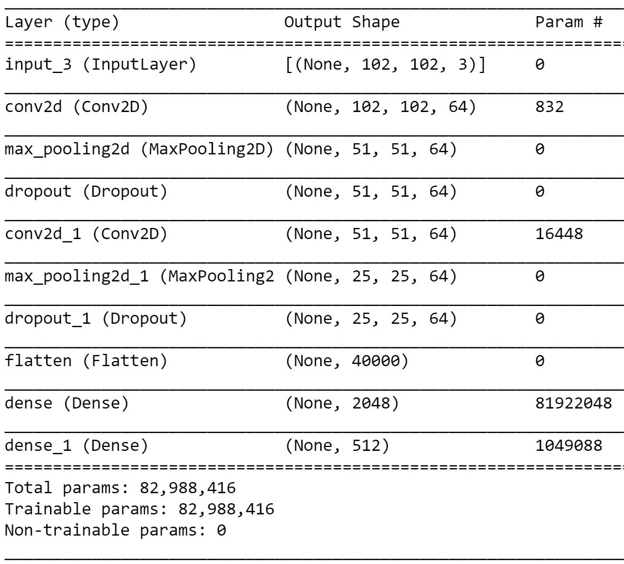
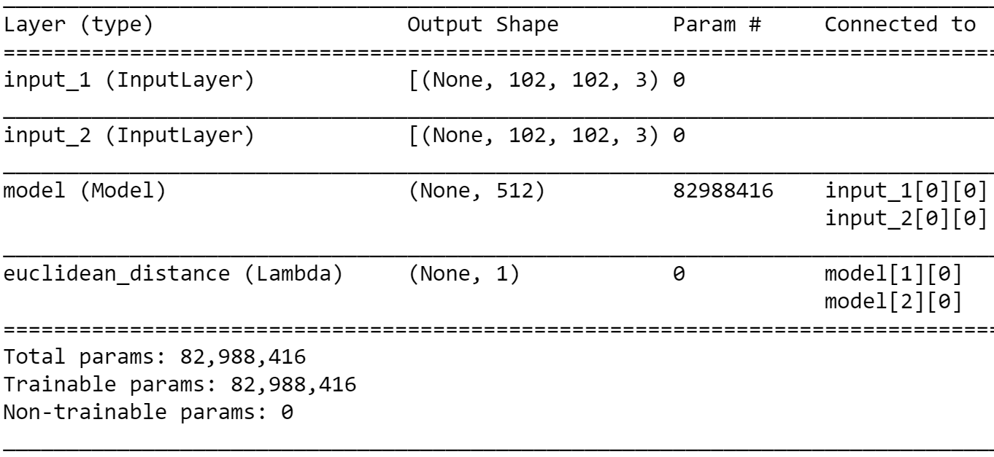
Implementation
Fig.: CNN architecture (feature extraction)
Fig: Siamese network architecture

Slide 30
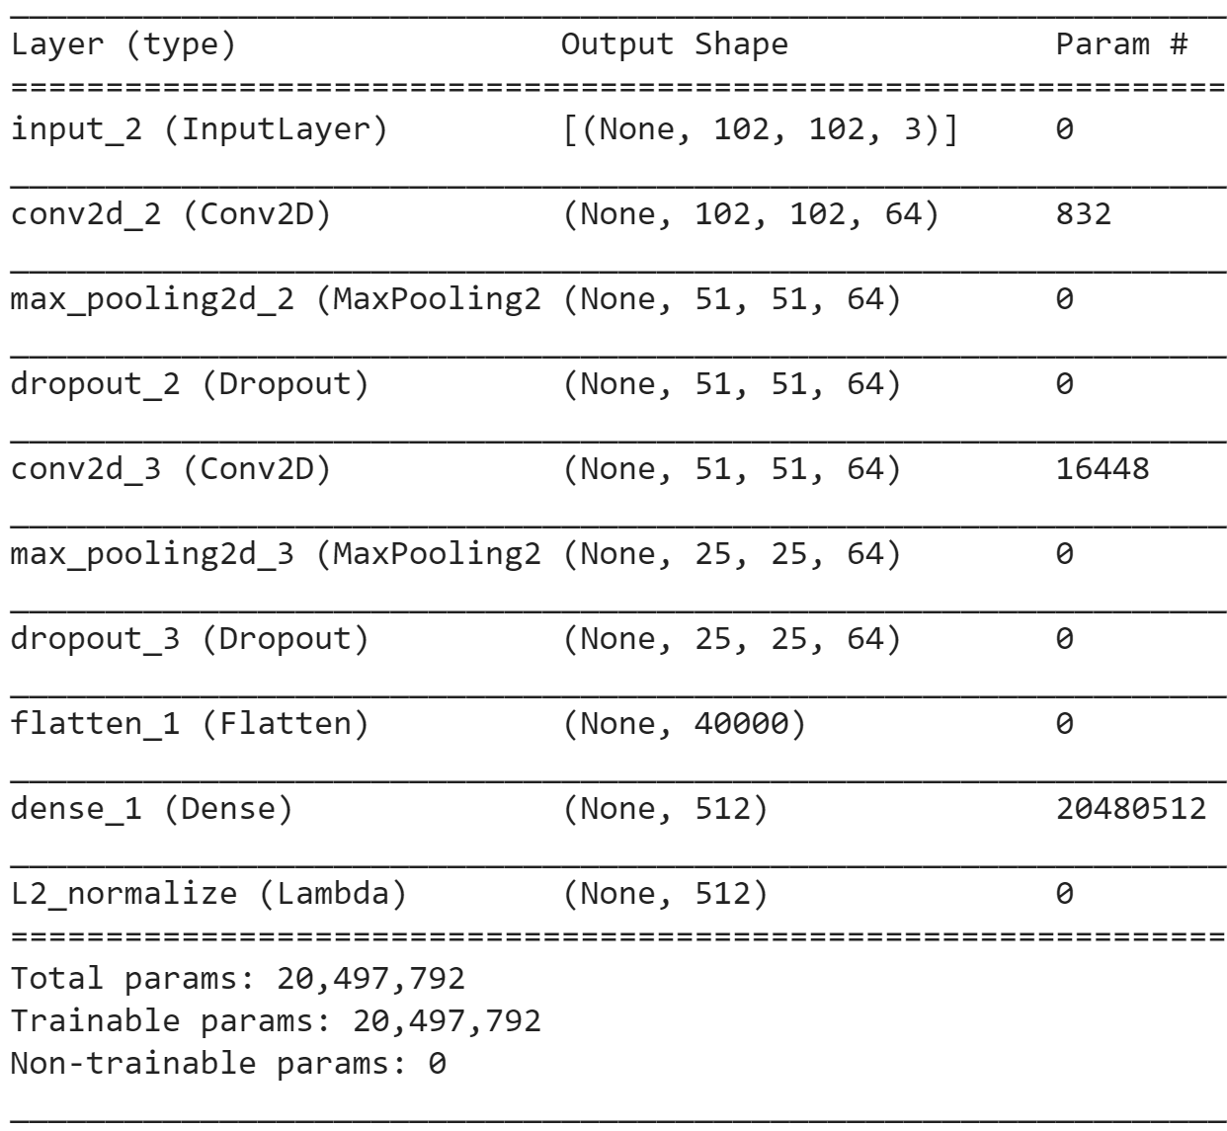
Implementation
Fig: Our Siamese architecture for triplet loss

Slide 31
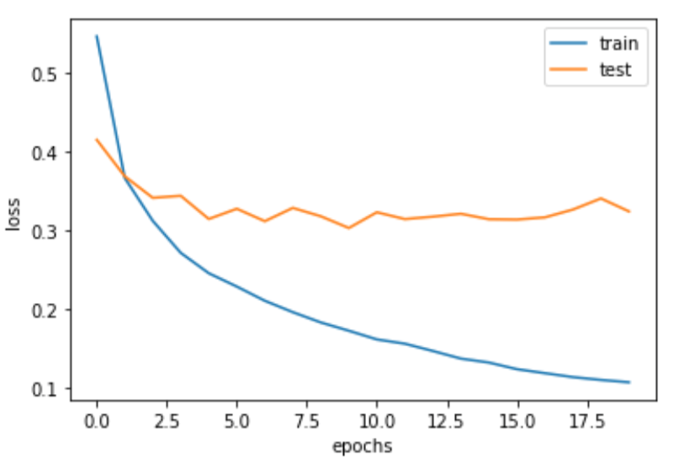
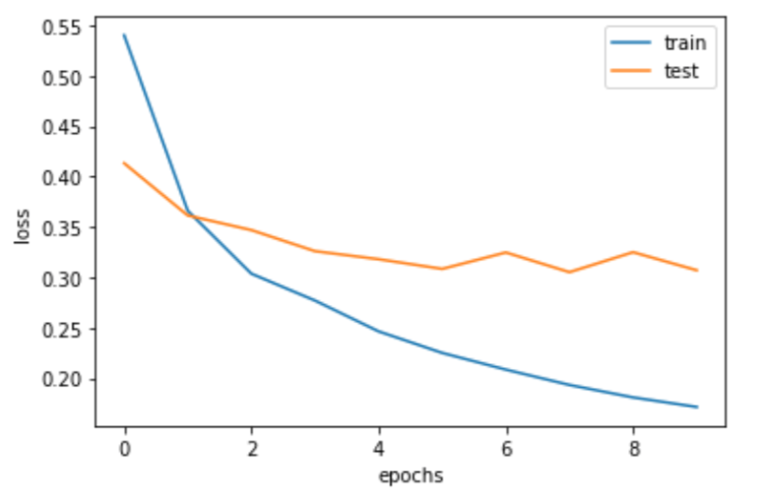
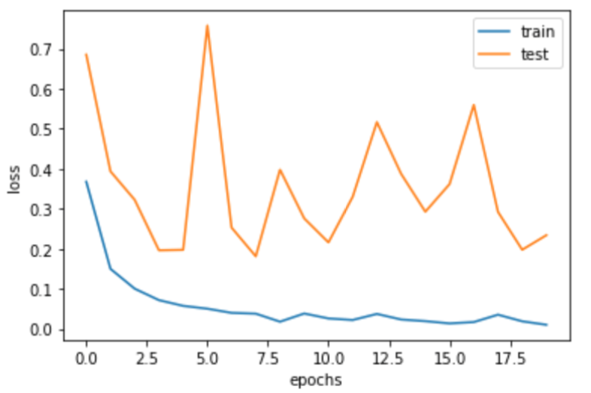
Transfer Learning
(a) Xception
(b) Xception + dense
(c) Xception All
Figure X: loss diagram for transfer learning

Slide 32
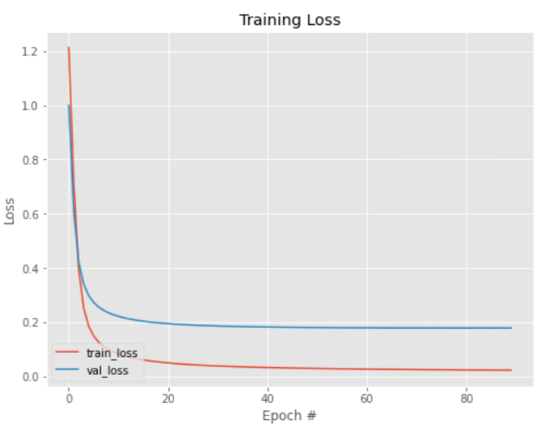
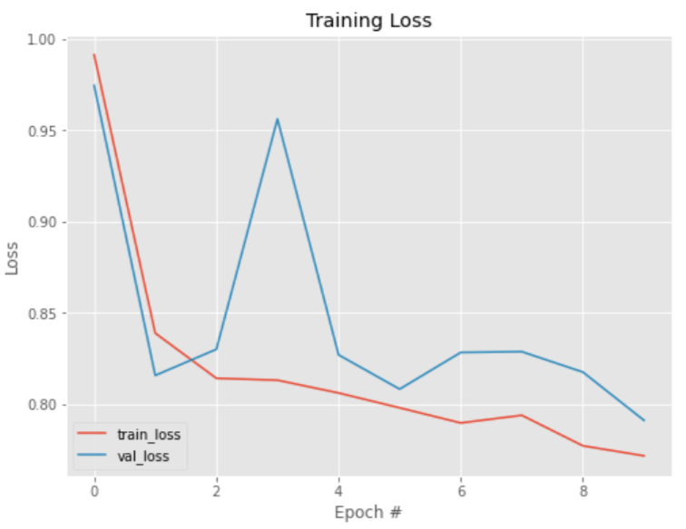
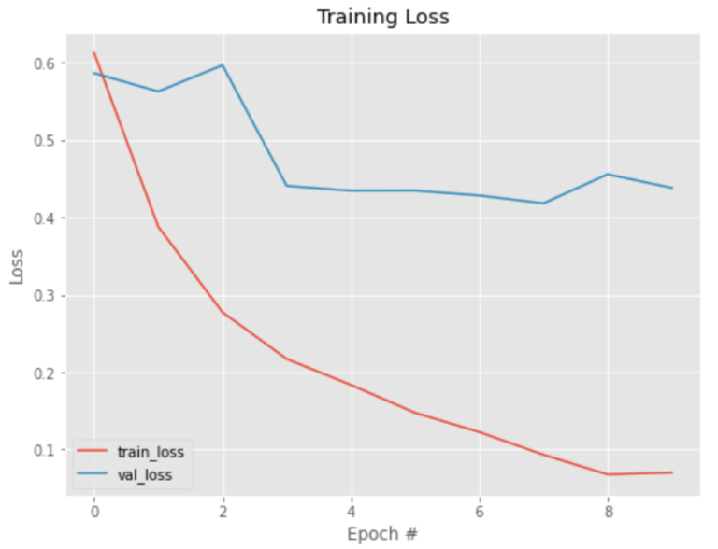
Contrastive Loss
Our Siamese + Con. loss
Our Siamese + Triplet. loss
Xception + Siamese
Figure X: loss diagram for transfer learning

Slide 33
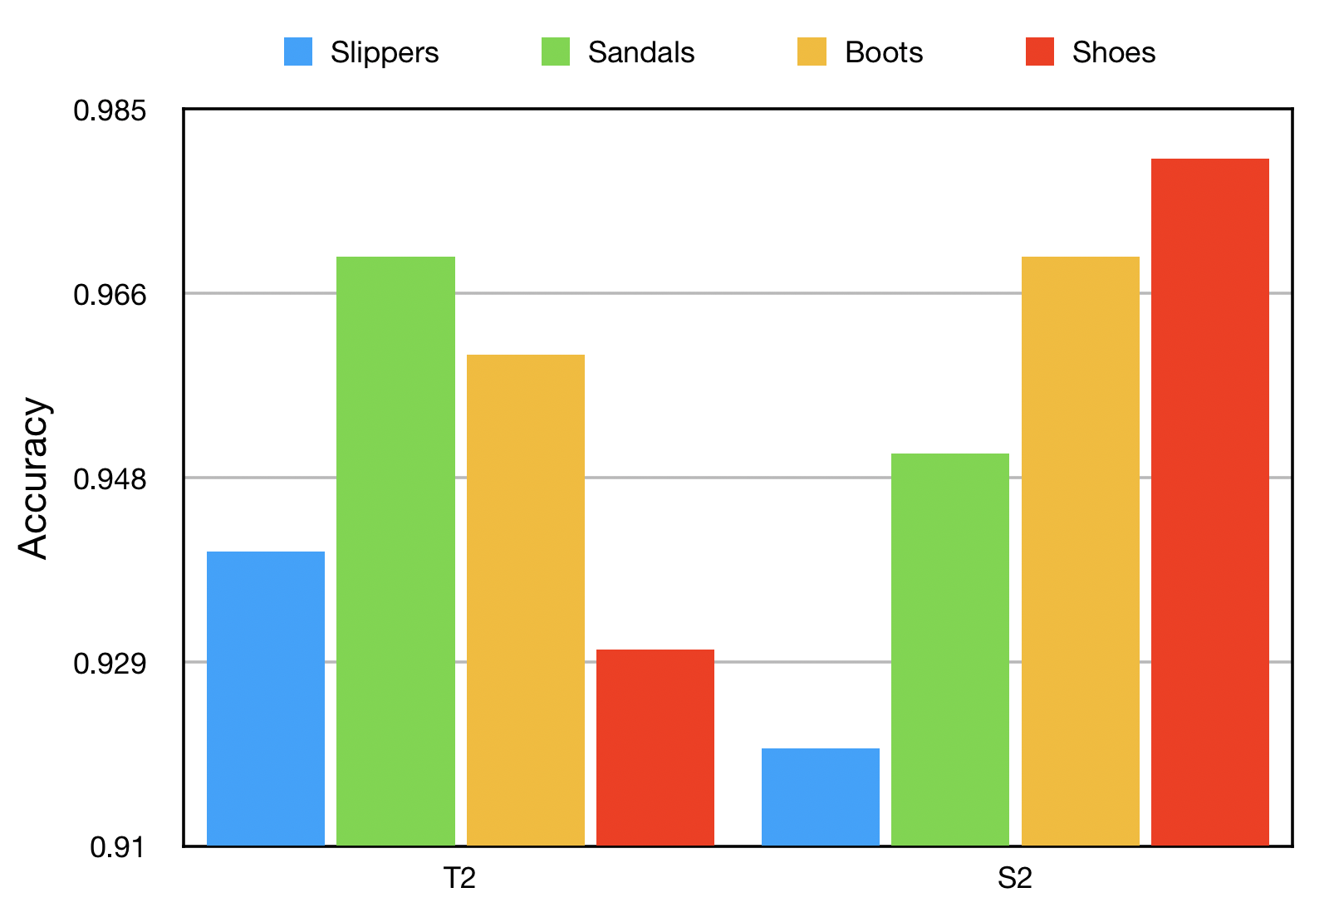
Analyze each class
Figure X: accuracy per class of best models

